Slide 1
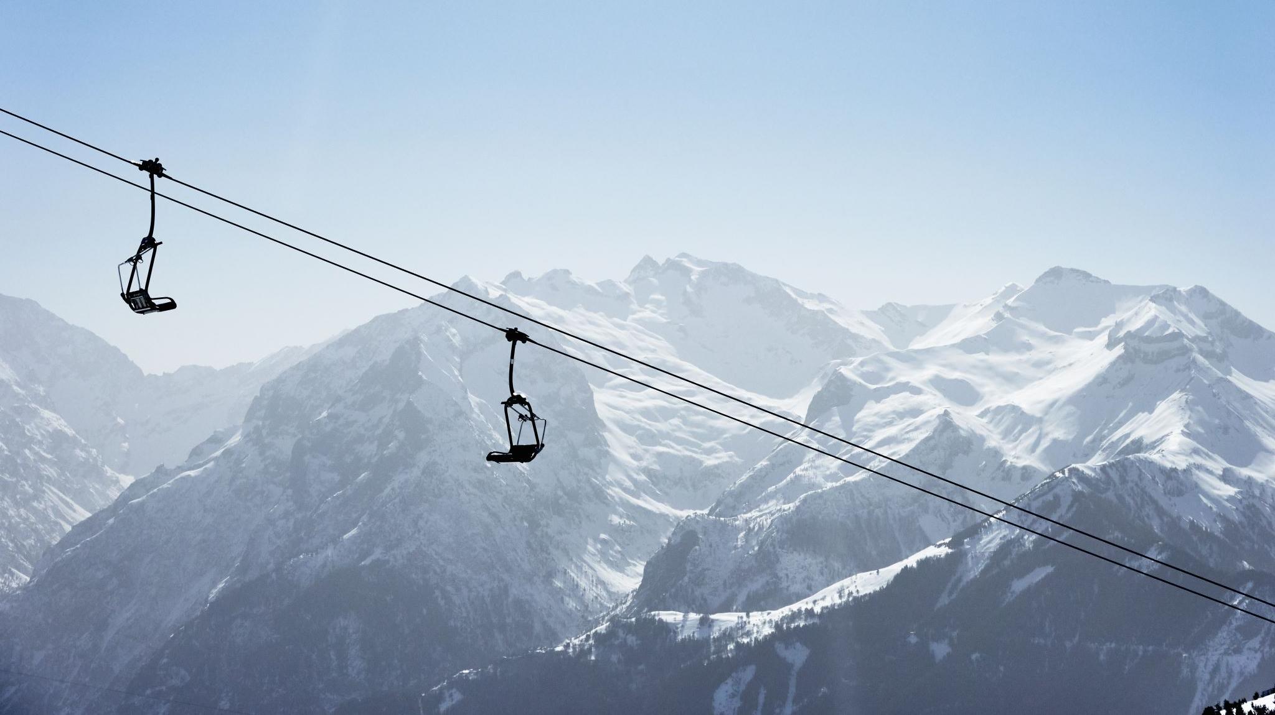
Big Mountain Resort
Pricing Analysis
Guided Capstone
Evan Meeks

Slide 2
Business Objective
Implement a new ticket pricing structure prior to the next ski season that offsets the $1,540,000 operational cost increase and better capitalizes on market positioning of Big Mountain Resort

Slide 3
Key Findings and Recommendations
BMR’s current pricing structure is amongst the in it’s market.
The number of fast quads, runs, vertical drop, and snow making acres are the largest contributors to ticket prices.
To immediately increase price by $1.99:
Add one additional ski run
Increase the vertical drop by 150ft by lowering the end point of a run
Add one additional chair lift to service the new end point and return customers to base

Slide 4
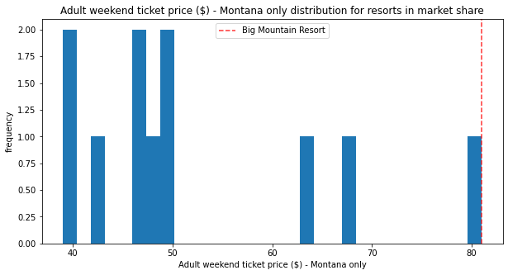
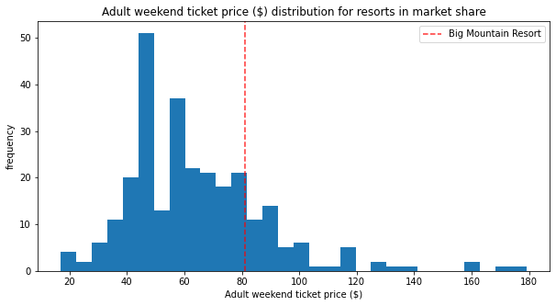
Modeling and Analysis
BMG’s Pricing is the highest in Montana, and amongst the highest in the nation:

Slide 5
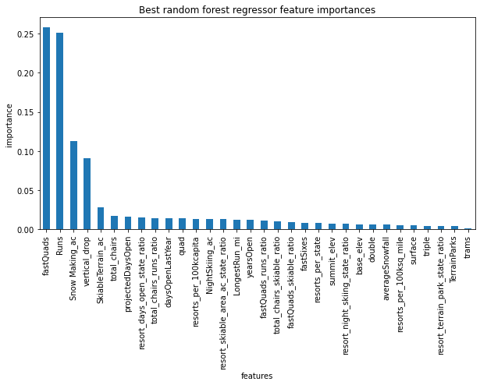
The Most Impactful Features

Slide 6
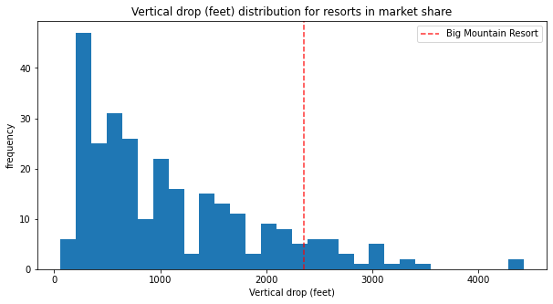
Vertical Drop

Slide 7
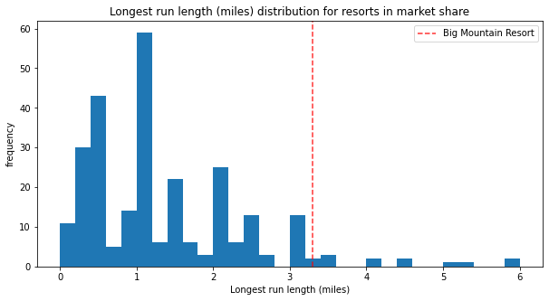
The Longest Run Lengths

Slide 8
Conclusion
Big Mountain Resort is already amongst the most premium of resort. However, ticket prices can support an additional $1.99/ticket and generate approximately $3,474,638 annually by completing making the changes outlined within this presentation.

